Slide 1

PROJECT INTRODUCTION
EASY
ADVANCED

Slide 2
INTRODUCTION AND KEY LEARNING OUTCOMES
We will also analyze university admission datasets in AWS SageMaker Studio and train an XG-Boost algorithm in Scikit-Learn to solve regression problems.
We will learn how to:
Perform data visualization using Seaborn and Matplotlib libraries
Understand the theory and intuition behind boosting
Learn the advantages and disadvantages of XG-boost algorithm
Train an XG-boost algorithm in Scikit-Learn to predict university admission
Train an XG-boost algorithm in Scikit-Learn to predict life expectancy (capstone project)
Assess trained models performance

Slide 3

PROJECT CARD
GOAL:
Build, train, test and deploy an XG-Boost model to predict chances of university admission into a particular university given student’s profile.
TOOL:
AWS SageMaker Studio & Scikit-Learn
PRACTICAL REAL-WORLD APPLICATION:
This project can be effectively used by university admission departments to determine top qualifying students.
DATA:
INPUTS (FEATURES):
GRE Scores (out of 340)
TOEFL Scores (out of 120)
University Rating (out of 5)
Statement of Purpose (SOP)
Letter of Recommendation (LOR) Strength (out of 5)
Undergraduate GPA (out of 10)
Research Experience (either 0 or 1)
OUTPUTS:
Chance of admission (ranging from 0 to 1)
Image Source: https://www.flickr.com/photos/pasa/6757993805
Dataset Source: https://www.kaggle.com/ljanjughazyan/cars1
Data Source: https://www.kaggle.com/mohansacharya/graduate-admissions
Photo Credit: https://www.pexels.com/photo/accomplishment-ceremony-education-graduation-267885/

Slide 4
PROJECT OVERVIEW
INPUTS
GRE Score
TOEFL Score
University Rating
Statement of Purpose (SOP)
Letter of Recommendation (LOR)
CGPA
Research
MACHINE LEARNING MODEL
OUTPUT
Chance of Admission

Slide 5
XG-BOOST ALGORITHM
EASY
ADVANCED

Slide 6

XGBOOST: INTRODUCTION
XGBoost or Extreme gradient boosting is the algorithm of choice for many data scientists and could be used for regression and classification tasks.
XGBoost is a supervised learning algorithm and implements gradient boosted trees algorithm.
The algorithm work by combining an ensemble of predictions from several weak models.
It is robust to many data distributions and relationships and offers many hyperparameters to tune model performance.
Xgboost offers increased speed and enhanced memory utilization.
Xgboost is analogous to the idea of “discovering truth by building on previous discoveries”.
This picture is derived from Greek mythology: the giant Orion carried his servant Cedalion on his shoulders to act as the giant's eyes.
"If I have seen further it is by standing on the shoulders of Giants”, Isaac Newton
Source: https://commons.wikimedia.org/wiki/File:Library_of_Congress,_Rosenwald_4,_Bl._5r.jpg

Slide 7
ADVANTAGES AND DISADVANTAGES OF XGBOOST
ADVANTAGES:
No need to perform any feature scaling
Can work well with missing data
Robust to outliers in the data
Can work well for both regression and classification
Computationally efficient and produce fast predictions
Works with distributed training: AWS can distribute the training process and data on many machines
DISADVANTAGES:
Poor extrapolation characteristics
Need extensive tuning
Slow training

Slide 8
DISADVANTAGES OF XGBOOST: POOR EXTRAPOLATION CAPABILITY BY XGBOOST
Out of bound inference with XGBoost will cause issues and result in unreasonable predictions
LINEAR REGRESSION
& ARTIFICIAL NEURAL NETWORKS
XGBOOST
& RANDOM FOREST
AGE
AGE
MODEL PREDICTIONS (INFERENCE)
TRAINING DATA
SAVINGS
SAVINGS

Slide 9
XG-BOOST ALGORITHM: WHAT IS BOOSTING?
EASY
ADVANCED

Slide 10
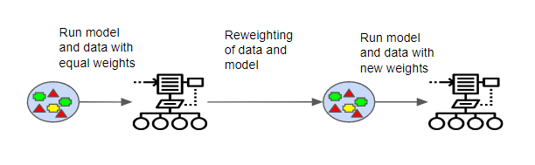
XGBOOST: WHAT IS BOOSTING?
Boosting works by learning from previous mistakes (errors in model predictions) to come up with better future predictions.
Boosting is an ensemble machine learning technique that works by training weak models in a sequential fashion.
Each model is trying to learn from the previous weak model and become better at making predictions.
Boosting algorithms work by building a model from the training data, then the second model is built based on the mistakes (residuals) of the first model. The algorithm repeats until the maximum number of models have been created or until the model provides good predictions.
Great Resource: https://medium.com/greyatom/a-quick-guide-to-boosting-in-ml-acf7c1585cb5
Photo Credit: https://commons.wikimedia.org/wiki/File:Boosting.png

Slide 11
XGBOOST: BOOSTING EXAMPLE
Model #1 works by attempting to classify the two classes (+) and (-) with the vertical line shown.
Model #1 has assigned equal weights to all data points since it has no prior knowledge or experience from before.
Model #1 misclassified 3 (+) samples.

Slide 12
XGBOOST: BOOSTING EXAMPLE
Model #2 learns from the mistakes of the previous model and assigns more weight to the wrongly classified data points (3 +) as shown in the figure below.
So model #2 draws a vertical separating line and “made sure” to properly classify these points this time!
The model did a great job correctly classifying points with higher weights but in the process, it has misclassified two red (-) samples.

Slide 13
XGBOOST: BOOSTING EXAMPLE
Model #3 learns from the mistakes of the previous model and assigns more weight to the wrongly classified data points (2 -) as shown in the figure below.
So model #3 draws a horizontal separating line and “made sure” to properly classify these points this time!
The model did a great job correctly classifying points with higher weights but in the process, it has misclassified two blue (+) samples.

Slide 14
XGBOOST: BOOSTING EXAMPLE
Model #4 combines all the mistakes from all these weak models to build a much stronger model that correctly classifies all data points.

Slide 15
XG-BOOST ALGORITHM: ENSEMBLE LEARNING
EASY
ADVANCED

Slide 16
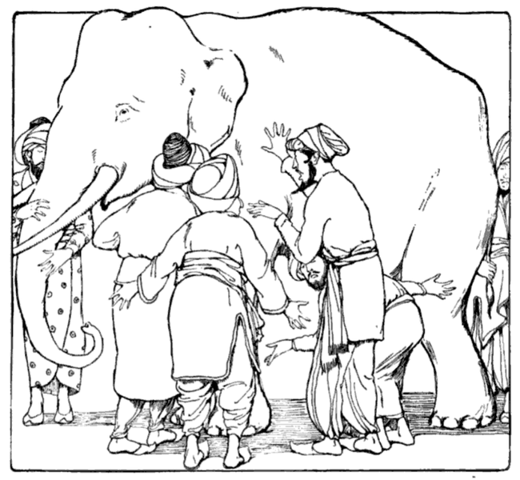
XGBOOST: WHAT IS ENSEMBLE LEARNING?
XGBoost is an example of ensemble learning.
Ensemble techniques such as bagging and boosting can offer an extremely powerful algorithm by combining a group of relatively weak/average ones.
For example, you can combine several decision trees to create a powerful random forest algorithm.
By Combining votes from a pool of experts, each will bring their own experience and background to solve the problem resulting in a better outcome.
Boosting can reduce variance and overfitting and increase the model robustness.
Example: Blind men and the elephant
Model #1
Model #2
Model #3
VOTING
Photo Credit: https://commons.wikimedia.org/wiki/File:Blind_men_and_elephant.png

Slide 17
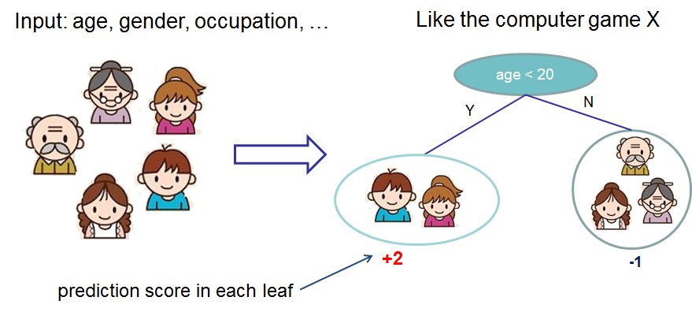
XGBOOST: DECISION TREES ENSEMBLES
Decision Trees are supervised Machine Learning technique where data is split according to a certain condition/parameter.
The tree consists of decision nodes and leaves.
Leaves are the decisions or the final outcomes.
Decision nodes are where the data is split based on a certain attribute.
The tree ensemble model consists of a set of classification and regression trees (CART).
A CART that classifies whether an individual will like a computer game X or not is shown below.
Members of the family are divided into leaves and a score is assigned to each leaf.
DECISION NODES
Source: https://xgboost.readthedocs.io/en/latest/tutorials/model.html
LEAVES

Slide 18
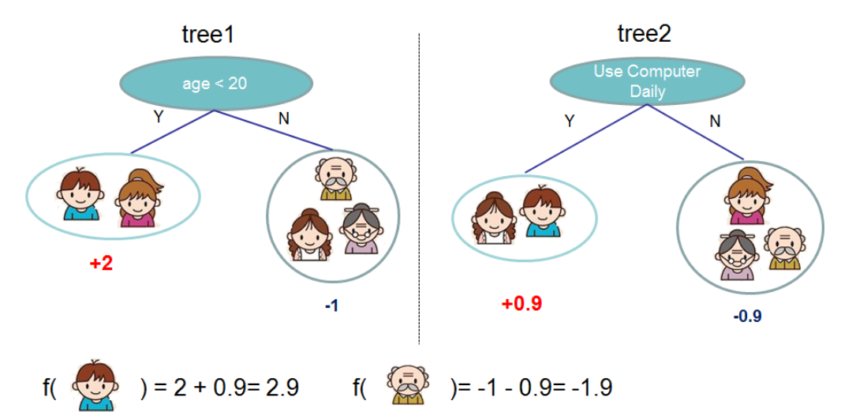
XGBOOST: DECISION TREES ENSEMBLES
Ensemble models that combines the predictions from all trees is built as shown below.
The prediction scores of each individual tree are summed up to get the final score.
Source: https://xgboost.readthedocs.io/en/latest/tutorials/model.html

Slide 19
XG-BOOST ALGORITHM: DEEP DIVE
EASY
ADVANCED

Slide 20
XGBOOST: STEPS
XGBoost repeatedly builds new models and combine them into an ensemble model
Initially build the first model and calculate the error for each observation in the dataset
Then you build a new model to predict those residuals (errors)
Then you add prediction from this model to the ensemble of models
XGboost is superior compared to gradient boosting algorithm since it offers a good balance between bias and variance (Gradient boosting only optimized for the variance so tend to overfit training data while XGboost offers regularization terms that can improve model generalization).
BUILD A MODEL TO PREDICT THOSE ERRORS
INITIAL MODEL (STARTING POINT)
CALCULATE THE ERRORS BASED ON THE PREVIOUS MODEL (RESIDUALS)
ADD LAST MODEL TO THE ENSEMBLE

Slide 21
XGBOOST: GRADIENT BOOSTING ALGORITHM
INITIAL GUESS (AVERAGE)
Y
N
Learning Rate
Y
N
Y
N
Y
N
LEARNING RATE
Y
N
Y
N
SCALING FACTOR
Y
N
LEARNING RATE
Y
N
Y
N

Slide 22
XGBOOST: GRADIENT BOOSTING ALGORITHM
Gradient boost works by building a tree based on the error (residuals) from the previous tree.
Gradient boost scales trees and then adds the predictions from the new tree to the predictions from previous trees.
Example adopted from the awesome StatQuest (by Josh Starmer): https://www.youtube.com/watch?v=3CC4N4z3GJc&t=87s
Height | Color | Gender | Weight (Kg)
1.6 | Blue | Male | 88
1.6 | Green | Female | 76
1.5 | Blue | Female | 56
1.8 | Red | Male | 73
1.5 | Green | Male | 77
1.4 | Blue | Female | 57
VARIABLE TO BE PREDICTED
INPUT FEATURES

Slide 23
XGBOOST: GRADIENT BOOSTING ALGORITHM
Let’s assume that the initial model predictions (starting point) is the average weight is 71.2
Gradient boost builds a tree based on the error from the first tree.
The tree is built by assuming that the features (heights, color, and gender) predicts the residuals (new column that we have just created).
71.2
INITIAL STARTING POINT (PREDICTIONS)
Height | Color | Gender | Weight (Kg)
1.6 | Blue | Male | 88
1.6 | Green | Female | 76
1.5 | Blue | Female | 56
1.8 | Red | Male | 73
1.5 | Green | Male | 77
1.4 | Blue | Female | 57
Error = True – predicted
88-71.2=16.8
76-71.2=4.8
56-71.2=-15.2
73-71.2=1.8
77-71.2=5.8
57-71.2=-14.2
Is female?
Y
N
Height <1.6
Is not Blue?
Y
N
Y
N
-15.2,
-14.2
4.8
1.8, 5.8
16.8
INPUT FEATURES
ERRORS (RESIDUALS)
Example adopted from the awesome StatQuest (by Josh Starmer): https://www.youtube.com/watch?v=3CC4N4z3GJc&t=87s

Slide 24

XGBOOST: GRADIENT BOOSTING ALGORITHM
Note that the number of leaves is restricted to 4 in this example for the sake of simplicity.
Let’s replace the values with the average a shown below.
Is female?
Is female?
Y
N
Y
N
Height <1.6
Is not Blue?
Height <1.6
Is not Blue?
Y
N
Y
N
Y
N
Y
N
-15.2,
-14.2
4.8
1.8, 5.8
16.8
-14.7
4.8
3.8
16.8
$$Average_{1} =(−15.2−14.2)/2=−14.7$$
$$Average_{2} =(1.8+5.8)/2=3.8$$
Example adopted from the awesome StatQuest (by Josh Starmer): https://www.youtube.com/watch?v=3CC4N4z3GJc&t=87s

Slide 25
XGBOOST: GRADIENT BOOSTING ALGORITHM
Now that we have built a tree, let’s combine the previous predictions with the new tree to generate new predictions!
Is female?
Y
N
71.2
Height <1.6
Is not Blue?
AVERAGE WEIGHT (INITIAL GUESS FROM PREVIOUS STEP
Y
N
Y
N
-14.7
4.8
1.8, 5.8
16.8
The model predictions match the true weight. This indicates that the model is overfitting the training data
Height | Color | Gender | Weight (Kg)
1.6 | Blue | Male | 88
1.6 | Green | Female | 76
1.5 | Blue | Female | 56
1.8 | Red | Male | 73
1.5 | Green | Male | 77
1.4 | Blue | Female | 57
New predictions
88
Predictions = 71.2+16.8=88
Example adopted from the awesome StatQuest (by Josh Starmer): https://www.youtube.com/watch?v=3CC4N4z3GJc&t=87s

Slide 26
XGBOOST: GRADIENT BOOSTING ALGORITHM
We add a learning rate (range from 0 to 1) to overcome this issue.
This parameter is used for scaling purposes by adjusting the newly added information from the new tree.
Adding this tree and scaling it with the learning rate helps us get a little closer to the true values.
By taking smaller steps, the model results in better predictions on the testing dataset (low variance).
Is female?
71.2
Y
N
LEARNING RATE 0.1
Height <1.6
Is not Blue?
AVERAGE WEIGHT (INITIAL GUESS FROM PREVIOUS STEP
Y
N
Y
N
-14.7
4.8
1.8, 5.8
16.8
Height | Color | Gender | Weight (Kg)
1.6 | Blue | Male | 88
1.6 | Green | Female | 76
1.5 | Blue | Female | 56
1.8 | Red | Male | 73
1.5 | Green | Male | 77
1.4 | Blue | Female | 57
New predictions
72.9
Predictions = 71.2+ 0.1 * 16.8=72.9

Slide 27
XGBOOST: GRADIENT BOOSTING ALGORITHM
Now let’s build another tree with the new residuals from the new predictions.
Initial Residuals
16.8
4.8
-15.2
1.8
5.8
-14.2
RECALL THAT THESE ARE THE INITIAL RESIDUALS
Predictions = 71.2+ 0.1 * 16.8=72.9
RESIDUALS HAVE GONE DOWN!
Height | Color | Gender | Weight (Kg)
1.6 | Blue | Male | 88
1.6 | Green | Female | 76
1.5 | Blue | Female | 56
1.8 | Red | Male | 73
1.5 | Green | Male | 77
1.4 | Blue | Female | 57
New predictions | New Residuals
72.9 | 88-72.9 = 15.1
 | 4.3
 | -13.7
 | 1.4
 | 5.4
 | -12.7

Slide 28
XGBOOST: GRADIENT BOOSTING ALGORITHM
Is female?
71.2
Y
N
LEARNING RATE 0.1
Height <1.6
Is not Blue?
AVERAGE WEIGHT (INITIAL GUESS FROM PREVIOUS STEP
Y
N
Y
N
-14.7
4.8
1.8, 5.8
16.8
Is female?
NOW YOU CAN MAKE NEW PREDICTIONS BY COMBINING ALL THE SCALED PREDICTIONS FROM ALL TREES
Y
N
LEARNING RATE 0.1
Height <1.6
Is not Blue?
Y
N
Y
N
Is female?
Y
N
LEARNING RATE 0.1
Height <1.6
Is not Blue?
Y
N
Y
N

Slide 29
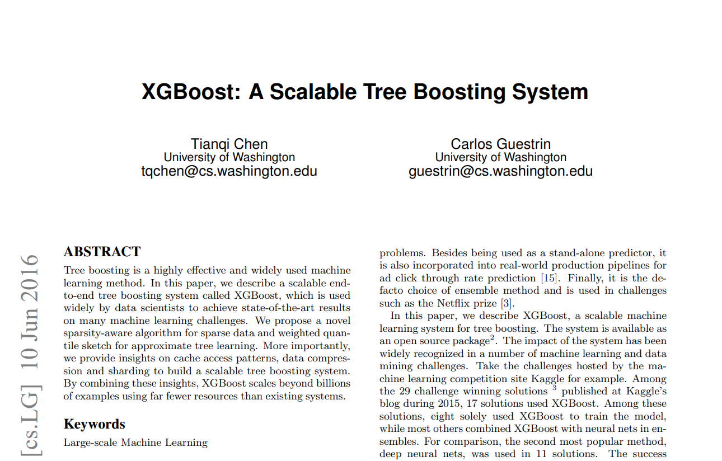
XGBOOST: WHAT IS THE EXTREME GRADIENT BOOSTING THEN? GREAT RESOURCES
Paper: https://arxiv.org/pdf/1603.02754.pdf
https://xgboost.readthedocs.io/en/latest/tutorials/model.html

Slide 30
XGBOOST: PAPER HIGHLIGHTS
“The most important factor behind the success of XGBoost is its scalability in all scenarios. The system runs more than ten times faster than existing popular solutions on a single machine and scales to billions of examples in distributed or memory-limited settings.”
“The scalability of XGBoost is due to several important systems and algorithmic optimizations. These innovations include: a novel tree learning algorithm is for handling sparse data; a theoretically justified weighted quantile sketch procedure enables handling instance weights in approximate tree learning. Parallel and distributed computing makes learning faster which enables quicker model exploration”.
“More importantly, XGBoost exploits out-of-core computation and enables data scientists to process hundred millions of examples on a desktop”.
“Finally, it is even more exciting to combine these techniques to make an end-to-end system that scales to even larger data with the least amount of cluster resources”.
Paper: https://arxiv.org/pdf/1603.02754.pdf

Slide 31
CODE DEMO
EASY
ADVANCED

Slide 32
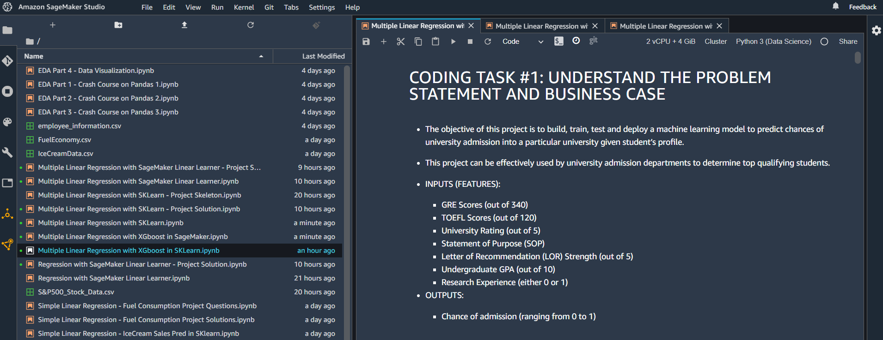
CODE DEMO: XG-BOOST IN SAGEMAKER

Slide 33
FINAL END-OF-DAY CAPSTONE PROJECT
EASY
ADVANCED

Slide 34
PROJECT OVERVIEW: LIFE EXPECTANCY PREDICTION
In this hands-on project, we will train an XG-Boost model to predict life expectancy.
This data was initially obtained from World Health Organization (WHO) and United Nations Website. Data contains features like year, status, life expectancy, adult mortality, infant deaths, percentage of expenditure, alcohol etc.
Tasks:
Perform exploratory data analysis
Train an XG-boost algorithm in Scikit-Learn
Assess trained model performance
Plot trained model predictions vs. ground truth output
INPUT FEATURES
PREDICTION
YEAR
ADULT MORTALITY
STATUS
INFANT DEATHS
ALCOHOL
HEPATITIS B
XG-BOOST MODEL
LIFE EXPECTANCY
Source: https://www.kaggle.com/jkumarajarshi/life-expectancy-who

